Slide 1
THE DARKSIDE OF SOCIAL MEDIA
Presented By: Satyam Prakash
Roll No. 202CS027
National Institute Of Technology, Karnataka

Slide 2
Contents
Introduction
Problem
Significance of problem
Existing Solution
Research gaps
Future Research Directions
Conclusion
References

Slide 3
Introduction
What is Social Media ?
Social media are interactive technologies that facilitate the creation or sharing of information, ideas, career interests and other form of expression via virtual communities and network.
Social media is of many types, some of them are :-
Social networking sites such as Facebook.
Image sharing and Messaging sites such as Instagram.
Video sharing sites such as YouTube.
Social community and discussion sites such as Reddit.

Slide 4
Although social media has many advantages like it helps in connectivity between the people, it is a source of latest information and updates, used for promotion and advertising, creating awareness, helps in building communities of people etc, there is an increasing number of incidents demonstrate that there is undoubtedly a “dark side” to social media.
For example, there have been an increasing number of reports and research attention into concerns such as cyber bullying, trolling, privacy invasion, fake news and addictive use.

Slide 5

Chamath Palihapitiya,
a former Facebook executive
stated that
“I think we have created tools that are ripping apart the social fabric of how society works”

Slide 6
Problem
Around 40% of the world’s population, use online social media and spending an average of two hours every day sharing, liking, tweeting and updating on these platforms and likely face problems.
Multiple studies have found a strong link between heavy social media and an increased risk for depression, anxiety, loneliness, self-harm, and even suicidal thoughts.
Let’s see some of the problems associated with usage of social media :-

Slide 7
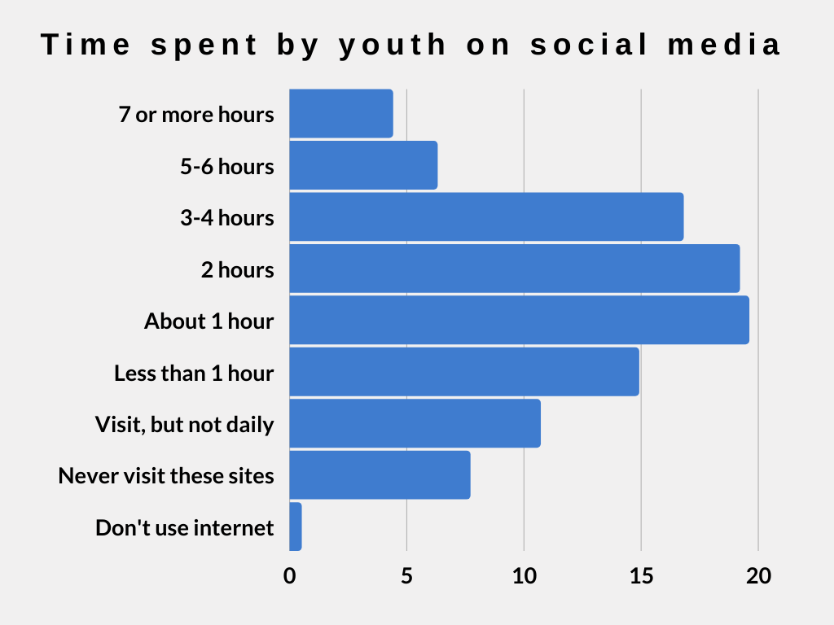
Spending Too Much Time On Social Media
The majority of students in grades 7-12 visit social media daily. About 1 in 10 students spend five hours or more in these sites daily.
According to a study average time spent on social media daily in 2012 was 90 minutes and it jumped to 144 minutes in 2019 i.e. 60% increase.

Slide 8
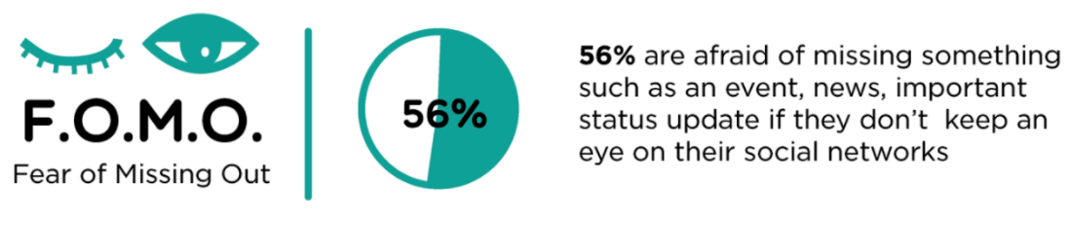
The FOMO Syndrome
FOMO stands for Fear Of Missing Out. It is a social anxiety originating from the belief that others might be having fun while the person experiencing the anxiety is not present. It involves a deep sense of envy and affects self-esteem.
Studies show that FOMO leads to extreme dissatisfaction and has a detrimental effect on our physical and mental health – mood swings, loneliness, feelings of inferiority, reduced self-esteem, extreme social anxiety, and increased levels of negativity and depression. It is not surprising that the use of anti-depressants has risen sharply in recent years due to FOMO.

Slide 9
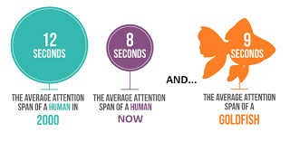
Neglecting Family and Responsibilities
Social networking platforms drove man closer to those in neighboring continents, while driving him further apart from those in his neighborhood.
Reducing Attention Span
National Centre for Biotechnology Information claimed that the average human attention span has dropped from 12 seconds in 2000 to 8 seconds in 2013, this effect is called Goldfish effect.

Slide 10
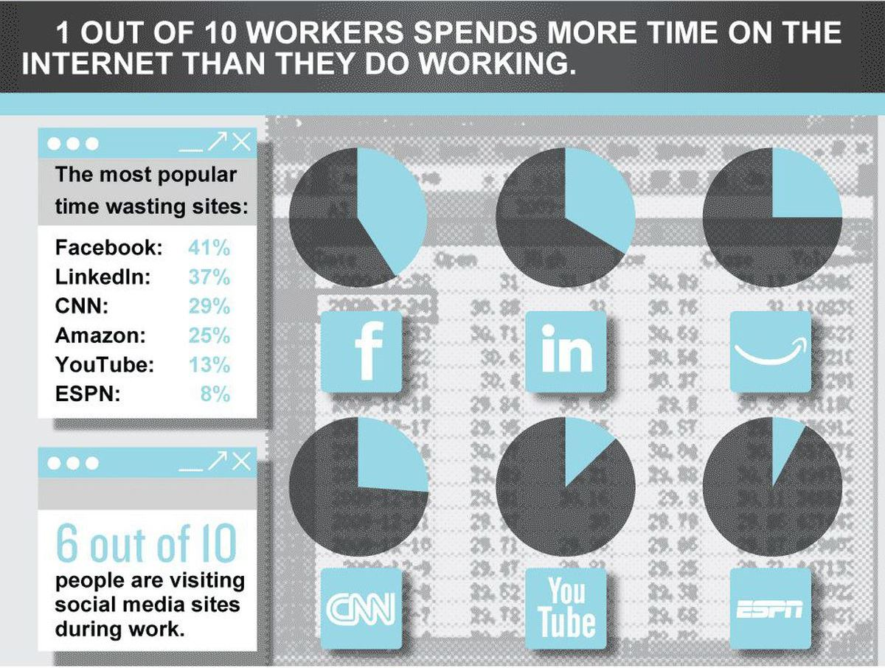
Reduced Productivity
Mashable reports that a social media interruption occurs every 10.5 minutes on average, and it then takes 23 minutes for those users to get back on task.

Slide 11
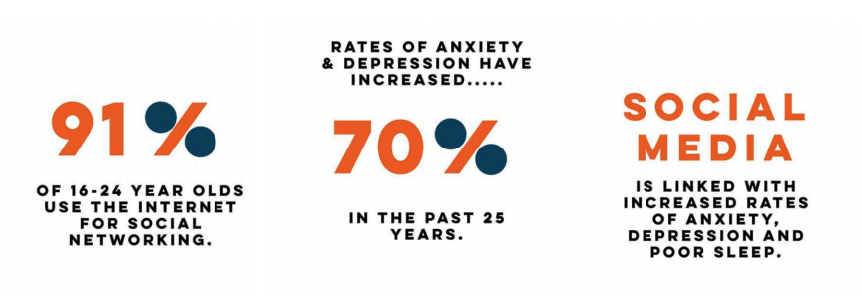
Privacy Issues
Criminals are expert at tricking social media users into handing over sensitive information, stealing personal data, and gaining access to accounts which users consider private.
Anxiety & Depression
One of the adverse effects of social media is depression. The greater we use social media, the less happy we seem to be. One study discovered that Facebook use was linked to both less happiness and less life satisfaction.

Slide 12

Addiction
It is generally defined as the compulsive use of social media platforms that results in significant impairment in an individual's function in various life domains over a prolonged period.
Aza Raskin, former Mozilla and Jawbone employee said
"Behind every screen on your phone, there are generally like literally a thousand engineers that have worked on this thing to try to make it maximally addicting".
He added that
“It's as if they're taking behavioral cocaine and just sprinkling it all over your interface and that's the thing that keeps you like coming back and back and back”.

Slide 13
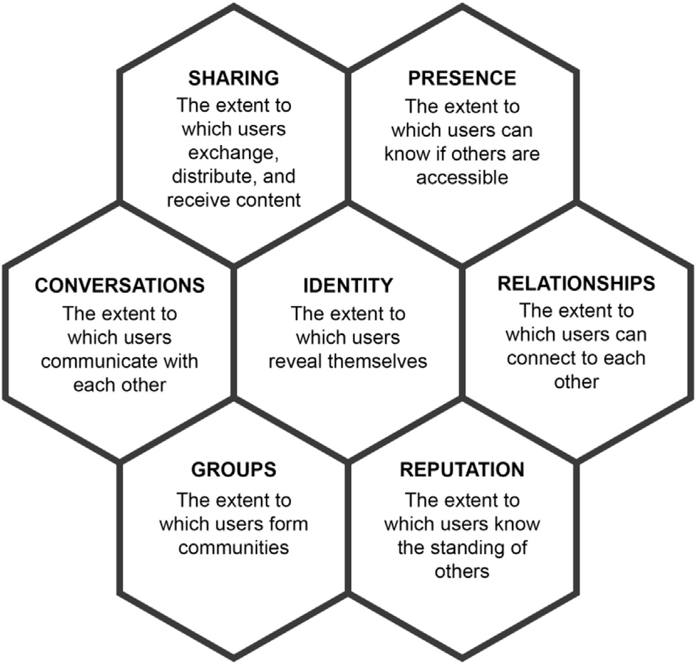
Significance of problem
Seven Building Block of Social Media
To understand how individuals, communities, and organizations can use different social media platforms to connect, monitor, and engage with each other, Kietzmann et al developed a honeycomb framework.
This framework unpacks social media functionalities into seven building blocks to describe different features of the social media user experience and the extent to which different social media are driven by each functionality.

Slide 14
Conversations: It refers to which users communicate with others using a social media platform. Twitter, Facebook, Instagram, LinkedIn, and many other platforms provide the ability to converse with functions such as “Like,” “Reply,” “Comment,” and “Direct Message.”
CONVERSATIONS
Misinformation,
disinformation and
aggressive engagement
Chatbots and social bots that mimic human behavior to pollute conversations in online space with spam and misleading advertisements.

Slide 15
Sharing: This aspect of a social media platform concerns the extent to which consumers exchange, distribute, and receive content. Consider for example how people use Flickr to share photos, YouTube to share videos, and Instagram to share photos and videos.
Once users can easily share content, a fundamental problem is that the shared content can be inappropriate and undesirable or that it can be shared without permission from the holder of any intellectual property rights (IPR) associated with the content.
SHARING
Inappropriate
distribution and
content

Slide 16
Presence: This functional block concerns the extent to which organizations and individuals know whether, where and when, others are accessible. This includes knowing the presence of others in an online world and/or in the real world.
The dark side of this functionality is that the location and availability of users are known and can be tracked without their awareness or consent.
PRESENCE
Location tracking
and
monitoring
From 2011 to 2015, the
default settings for Facebook Messenger were to collect and display geolocation information with message content.

Slide 17
Relationships: This building block is concerned with the extent to which users can relate to other users through social media platforms. In other words, users have some form of an association that determines why they engage with each other and the what-and-how of the content they exchange.
RELATIONSHIPS
Threat, coercion,
abuse,
intimidation
Estimates are that 10-40% of the youth are victims of cyber bullying
40% of those who cyber bully report they do so for fun, possibly connected with occurrence of jealousy.

Slide 18
Reputation: Degree to which users can identify and influence the standing of others, including themselves, in a social media setting.
The reputation of a social media user can be indicated by, for example, the number of followers someone has on Twitter, the sentiments of the comments expressed about a social media user, the view and like counts for a user's YouTube video.
REPUTATION
Shaming
and
defamation
Every year, numerous business and political leaders, and others, are forced to resign after posting offensive, disingenuous, or ridiculous content on social media.

Slide 19
Groups: This building block describes the function that social media users can create or join circles of friends or communities centered around a shared practice or interest.
The negative side of the groups building block, for instance, often shows its face through what social psychologists refer to as “ingroup-outgroup bias”.
GROUPS
In-group/out-group
bias
People define themselves in terms of social groupings (ingroup identity). They find themselves in an “echo-chamber” in which their own beliefs are amplified and reinforced, and those who do not fit into those groups (outgroups) are belittled.

Slide 20
Identity: Presenting one's identity is a central aspect of social media. Next to providing objective personal information, such as gender or age, users can also provide more subjective details that express their identity by, for example, joining groups with a specific topic or by liking, disliking, or commenting on content.
IDENTITY
Exploitation of
online self
Displaying one's identity online, however, has many downsides. A recent UK study found that the lack of privacy and protection on social media is one major concern of children and young people.

Slide 21
Existing Solutions
Regulations: Day by day new regulations are made for social media companies, such as handling of personal data and the accountability of social media platforms where user-generated content is shared.
Awareness: Creating awareness among users about the potential consequences of their actions on social media is essential. Many dark side social media incidents could be prevented if users were better informed about the real-life consequences of their online actions and the digital traces they leave behind on social media applications.

Slide 22
Mitigate distractions: Turn off pop-up notifications and other alerts that pull you into social when you have other things to focus on.
Resolve first: Know your goals and your limits. Be intentional about how much time you want to spend on social media. Define those limits up front.
Parents need to ensure that their children have adequate social interactions face to face.
Screen time should be limited as much as possible so that children and teenagers can spend more time with their family and real-life friends.
The important thing for parents is to maintain communication with their children to remind them how precious they are.

Slide 23
Research Gaps
Much of the research related to Dark side of Social Media has focused on multidimensionality of the dark side of social media and describe the related various undesirable outcomes based on social media honeycomb framework(functionality of a social media site) to explain the dark side implications of each of the seven functional building blocks: conversations, sharing, presence, relationships, reputation, groups, and identity. However, research is lacking on study on larger samples of people which are representative of a broader population in order to increase the respective study’s external validity.

Slide 24
Future Research Directions
There is a significant opportunity for future research studies using contemporary methodologies that suit the characteristics of social media. For instance, a recent and effective development for understanding online behaviour might be Netnography (a branch ethnography that analyses the free behaviour of individuals on the Internet that uses online marketing research techniques to provide useful insights.), which allows researchers to study social interaction in modern digital communication contexts.

Slide 25
Conclusion
Social networking communities are an intrinsic element of today’s web world. People use these sites as they want to be in touch with friends, exchange pictures or just kill time when bored. Companies too, have started engaging social media as a marketing tool for targeting their customers with relevant information and give more focus to them. many users are still ignorant or rather indifferent towards the security settings provided by the network and expose themselves to the risks that arise out of disclosing too much personal information. Social networks definitely can be definitely be informative and entertaining, but users should exercise caution and behave with the required level of uncertainty.

Slide 26
References
Baccarella, Christian & Wagner, Timm & Kietzmann, Jan & McCarthy, Ian. (2018). Social media? It's serious! Understanding the dark side of social media. European Management Journal. 36. 431-438. 10.1016/j.emj.2018.07.002.
https://www.statista.com/chart/15720/frequency-of-teenagers-social-media-use/
https://www.economist.com/graphic-detail/2018/05/18/how-heavy-use-of-social-media-is-linked-to-mental-illness
Kuss, Daria & Griffiths, Mark. (2012). Online social networking and addiction - A review of the psychological literature.

